Slide 1
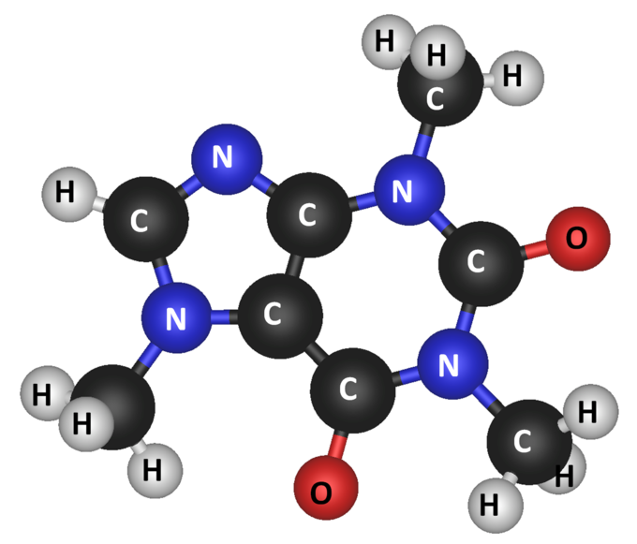

QuickSort for Molecules
Data Structures Programming Assignment
NTHU EE & CS
Caffeine
C₈H₁₀N₄O₂
Mass = 194.22

Slide 2
Objectives
Given several groups of molecules
There may be duplicated molecules
Each molecule has
A name string (e.g., "caffeine")
A formula string (e.g., "C8H10N4O2")
Molecular mass (can be zero or non-zero)
A zero means that your program needs to calculate the mass
A non-zero value means the mass is given
Quicksort each group of molecules according to the ascending order of molecular mass
Print out the molecules and also report the number of swaps used during Quicksort

Slide 3
Input
Number of groups
Name
Number of molecules in the group
Formula
2
6
silicon_carbide SiC 0
gallium(III)_nitride GaN 0
caffeine C8H10N4O2 0
silicon(IV)_dioxide SiO2 0
oxygen O 0
hydrogen H2 0
10
diethyl_ether CH3CH2OCH2CH3 74.14
addcrylonitrile H2C(CH)CN 53.07
amesite Mg2Al(AlSiO5)(OH)4 278.71
ammonium_hexathiocyanoplatinate(IV) (NH4)2[Pt(SCN)6] 579.66
maitotoxin C164H256Na2O68S2 3426.30
barysilate MnPb8(Si2O7)3 2217.08
montmorillonite_(clay) MgNaAl5(Si4O10)3(OH)6 1101.34
uranium_hexafluoride F6U 352.03
stearic_acid CH3(CH2)16COOH 284.54
cobalt(II)_ferricyanide Co3(Fe(CN)6)2 600.73
40 characters
25 characters
10

Slide 4
Processing Steps Example
1
Calculate molecular masses if necessary
silicon_carbide SiC 40.10
gallium(III)_nitride GaN 83.73
caffeine C8H10N4O2 194.22
silicon(IV)_dioxide SiO2 60.09
oxygen O 16.00
hydrogen H2 2.02
2
Perform Quicksort
40.10
83.73
194.22
60.09
16.00
2.02
40.10
2.02
194.22
60.09
16.00
83.73
40.10
2.02
16.00
60.09
194.22
83.73
16.00
2.02
40.10
60.09
194.22
83.73
2.02
16.00
40.10
60.09
194.22
83.73
2.02
16.00
40.10
60.09
83.73
194.22
swap
swap
swap
swap
swap

Slide 5
Output
Number of swaps
ascending order of molecular mass
2
6
hydrogen H2 2.00
oxygen O 16.00
silicon_carbide SiC 40.00
silicon(IV)_dioxide SiO2 60.00
gallium(III)_nitride GaN 84.00
caffeine C8H10N4O2 194.00
5 swaps during qsort
10
addcrylonitrile H2C(CH)CN 53.07
diethyl_ether CH3CH2OCH2CH3 74.14
amesite Mg2Al(AlSiO5)(OH)4 278.71
stearic_acid CH3(CH2)16COOH 284.54
uranium_hexafluoride F6U 352.03
ammonium_hexathiocyanoplatinate(IV) (NH4)2[Pt(SCN)6] 579.66
cobalt(II)_ferricyanide Co3(Fe(CN)6)2 600.73
montmorillonite_(clay) MgNaAl5(Si4O10)3(OH)6 1101.34
barysilate MnPb8(Si2O7)3 2217.08
maitotoxin C164H256Na2O68S2 3426.30
8 swaps during qsort
40 characters
25 characters
10

Slide 6
Appendix
Quicksort
Always pick the first entry of each partition as the pivot
Do not count swap(array, posi, posj) if posi == posj
Periodic table used in the assignment
Online molecular mass calculator (reference only)
https://www.webqc.org/mmcalc.php

